Slide 1
Configuration Management
SE489: DevOps Engineering

Slide 2
Outline
What is Configuration Management?
Before and After Configuration Management
Configuration Management Tools
What is Ansible?
Ansible Features
Ansible Case Study
Ansible for Orchestration, Provisioning, CM, AD, and Security

Slide 3
What is Configuration Management?

Slide 4
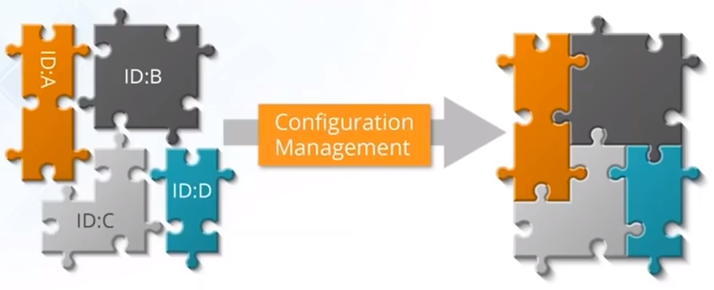
Configuration Management
Establish and maintain consistency of product performance
Maintain physical attributes with its requirements and design
Preserve operation information throughout its life

Slide 5

Configuration Management
Configuration management (CM) manages changes in the system or the server runtime environment.
Let's consider an example where we need to manage multiple servers with the same kind of configuration.
For example, we need to install Tomcat on each server.
What if we need to change the port on all servers, update some packages, or provide rights to some users?
Any kind of modification in this scenario is a manual and, if so, error-prone process.
As the same configuration is being used for all the servers, automation can be useful here.

Slide 6
Before and After Configuration Management

Slide 7



Before and After Configuration Management
Before
Problems in managing multiple servers
Application
Servers
After
Application
Application
Web Servers
DB Servers
App Servers
Servers
Servers

Slide 8

Before and After Configuration Management
Before
Scaling up of manual systems was a very tedious task
+
After
+

Slide 9



Before and After Configuration Management
Before
Code
Deploy
The work velocity of developers were affected since sysadmins were taking time to configure servers
Test Server
Prod Server
After
Code
Deploy
Code
Deploy
Test Server
Prod Server
Test Server
Prod Server

Slide 10
Before and After Configuration Management
Before
Upgrade
Rolling back was a problem since there was no tool to document the different versions of the application
Delete old version
Version 1
Version 2
Deploy new version
After
Upgrade
Upgrade
Delete old version
Delete old version
Version 1
Version 2
Version 1
Document old version
Version 2
Deploy new version
Deploy new version

Slide 11
Configuration Management Tools

Slide 12
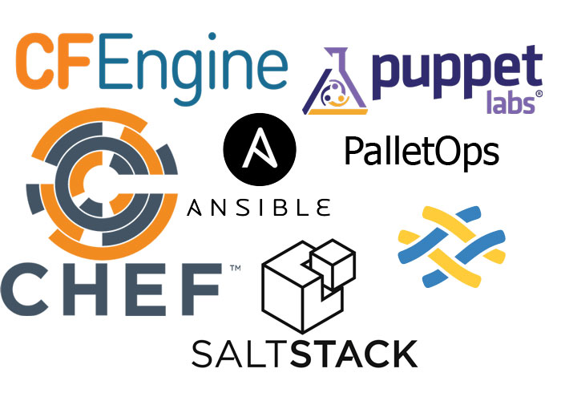
Configuration Management Tools

Slide 13
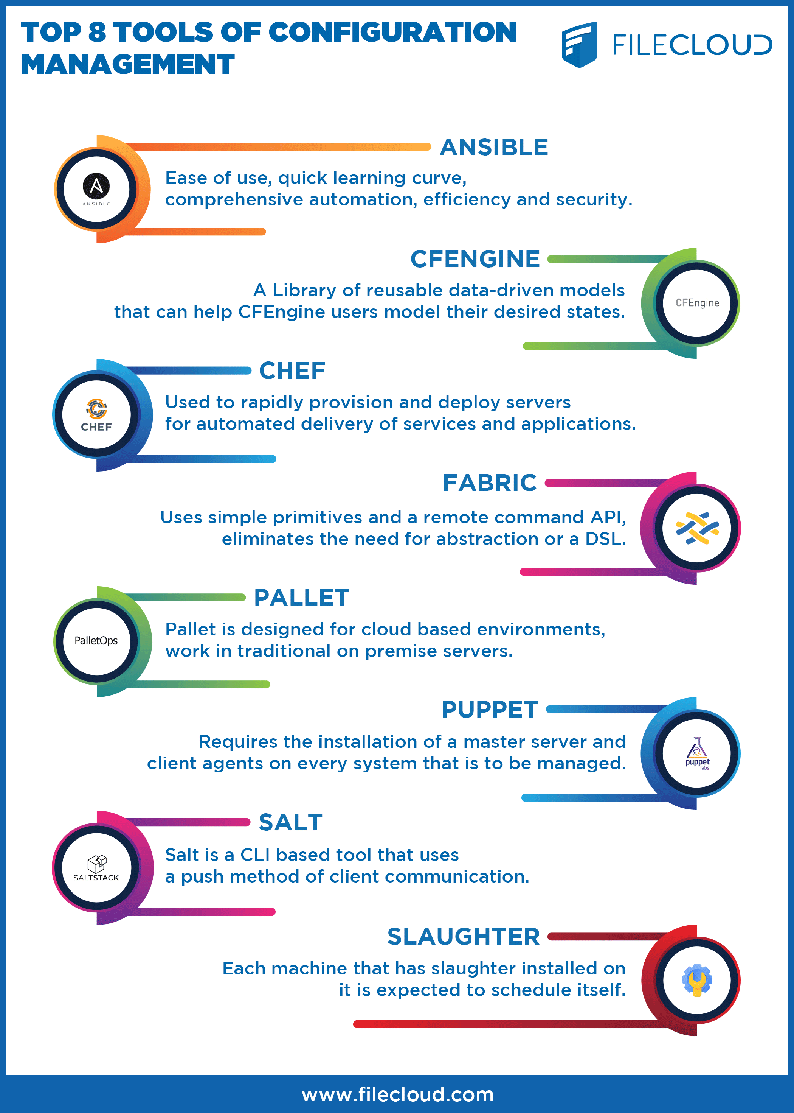

Slide 15
What is Ansible?

Slide 16
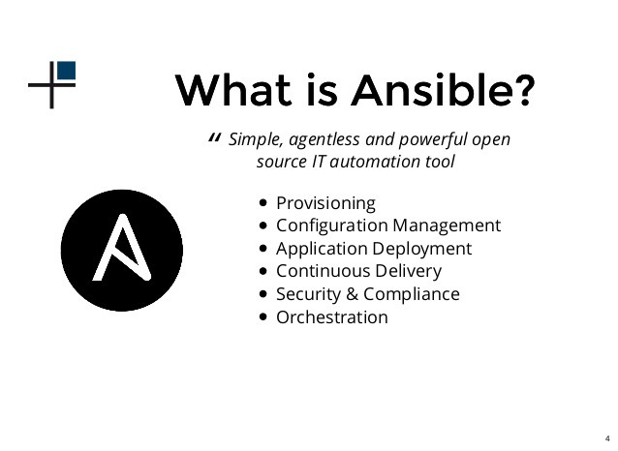
What is Ansible?

Slide 17

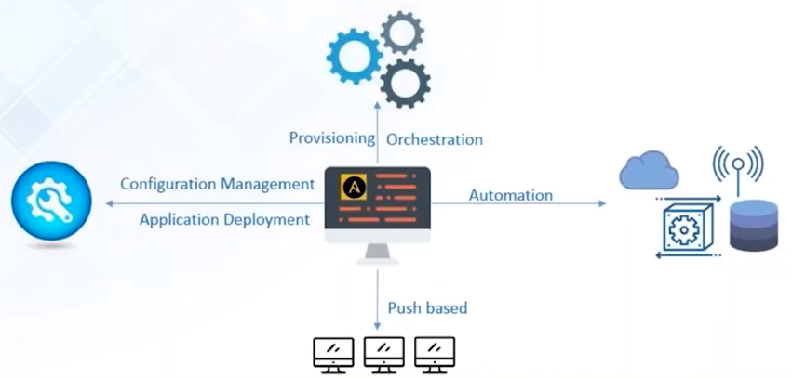
What is Ansible?
Ansible is a Configuration Management, Deployment, and Orchestration tool
It is a “push-based” Configuration Management tool
It automates your entire IT infrastructure by providing large productivity gain

Slide 18
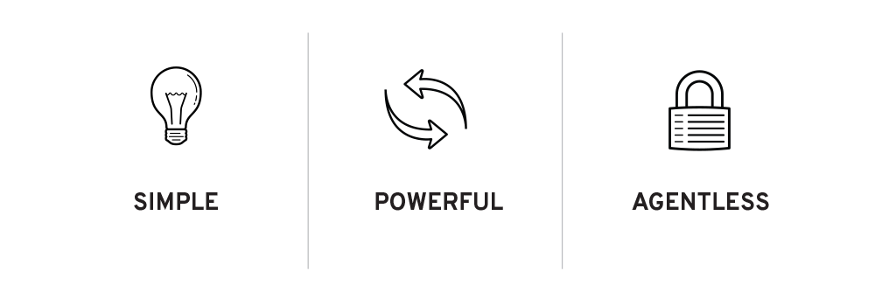
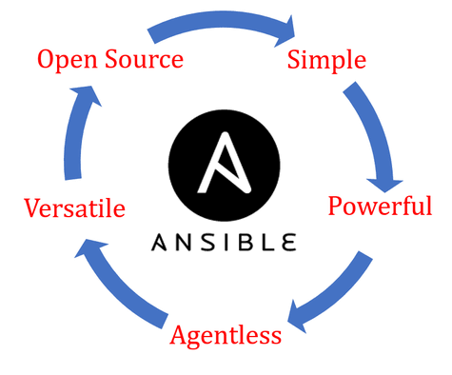

Ansible Features
Simple to install and setup and very easy to learn
No need for any agent or client software to manage nodes
Capabilities to model complex IT workflows and orchestrate your entire IT infrastructure
Extensible with modules written in any programming language
EFFICENT

Slide 19
Ansible Case Study

Slide 20
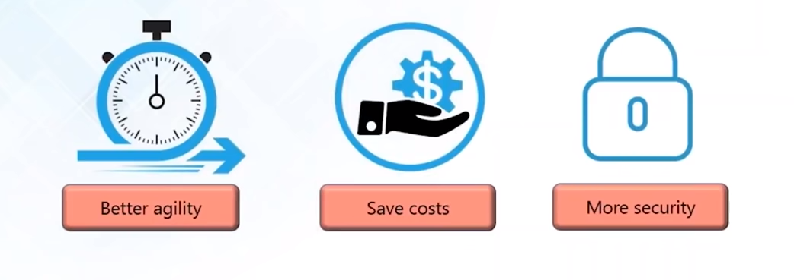

Ansible Case Study: NASA
NASA wanted to move 65 applications from traditional hardware based data centers to cloud based environment
What NASA wanted to achieve:

Slide 21
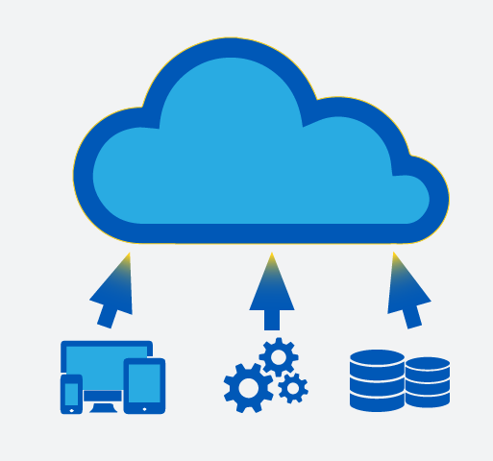
The problem …
Applications were migrated “as is” to cloud environment.
Environment spanning multiple VPCs and AWS accounts was created which couldn’t be easily managed
Managing access rights, security patching, and other simple tasks became tedious

Slide 22
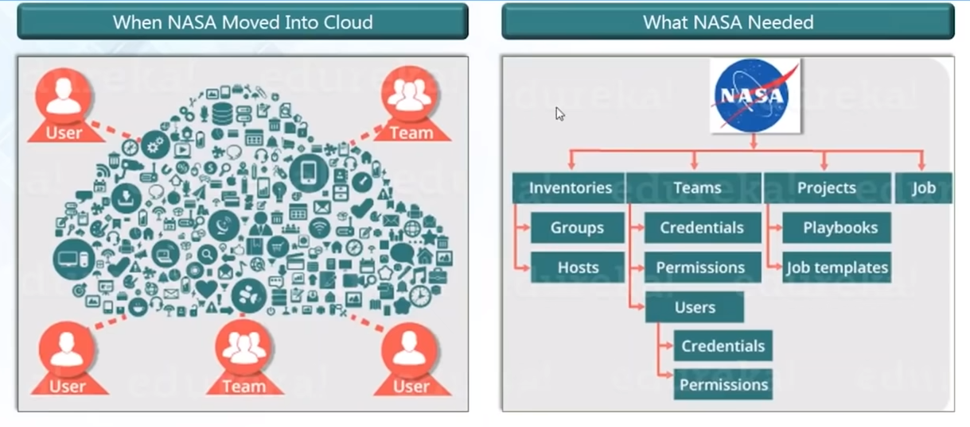
The problem …

Slide 23
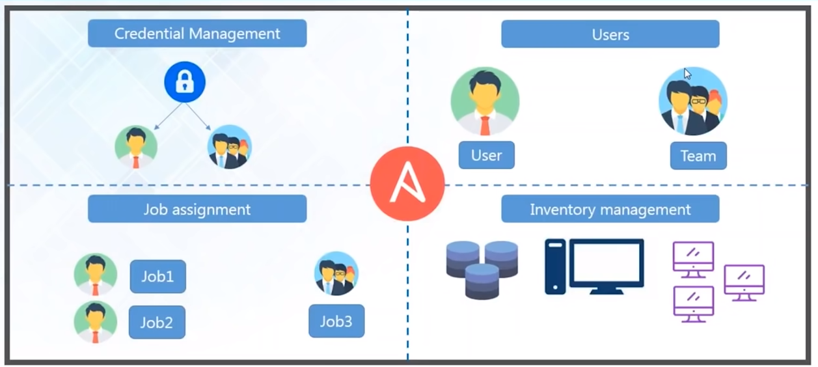
Ansible Tower to the rescue

Slide 24
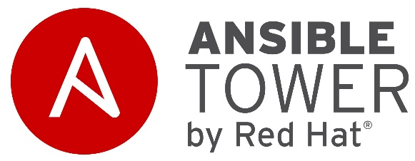
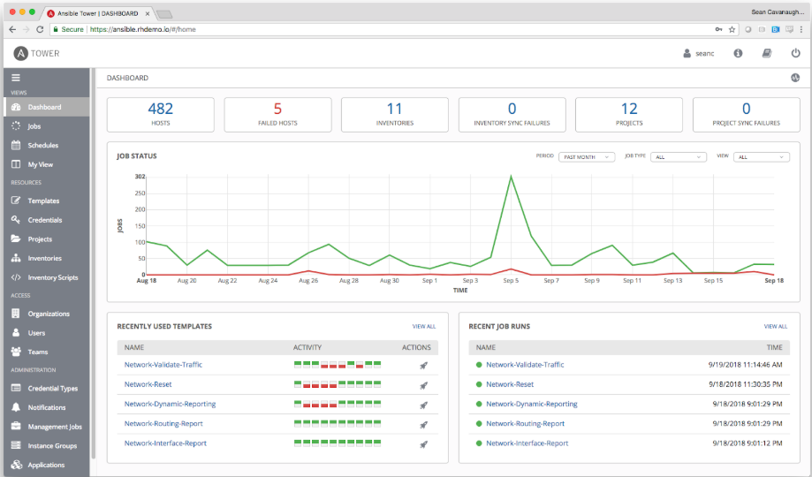
Ansible Tower Dahsboard
Provides status summary of all jobs
Divided organization into groups to manage access permissions

Slide 25
Results …
Updating nasa.gov went from 1 hour to 5 minutes
Security patching updates went from multi-day process to 45 minutes
Provisioning OS accounts across entire environment under 10 minutes
Application stacks set up time reduced from 1-2 hours to 10 minutes
Achieved near real-time RAM and disk-monitoring
Baselining standard AMIs from 1 hour manual process to invisible process

Slide 26
Ansible Architecture

Slide 27
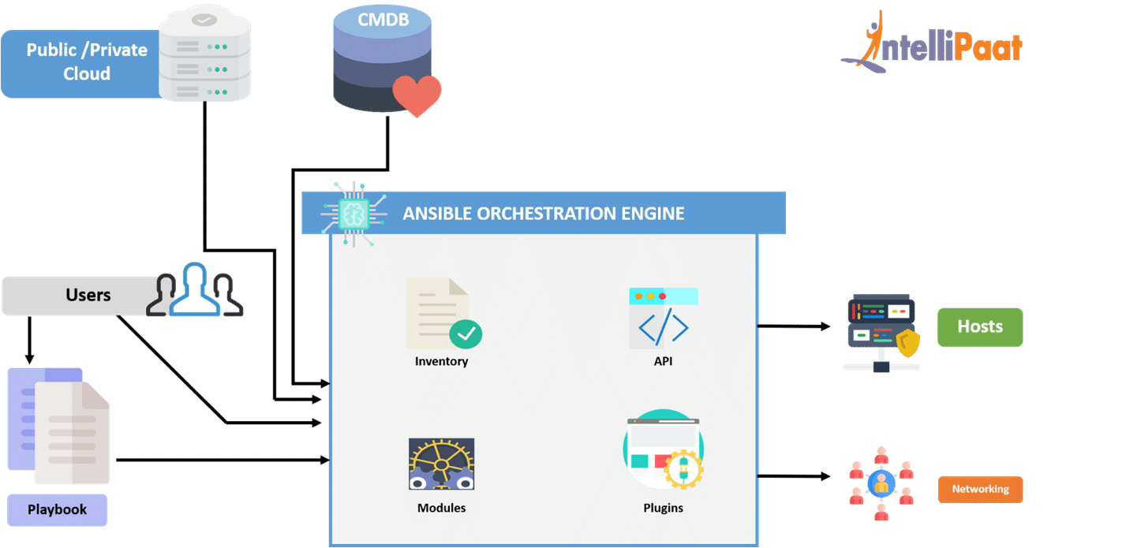
Ansible Architecture

